Slide 1
Housing Insecurity and Maternal Health in Illinois
Dr. Stacie Geller Co-PI IPROMOTE
G. William Arends Professor of Obstetric and Gynecology
Director, Center for Research on Women and Gender
College of Medicine, University of Illinois, Chicago
Date: November 2023

Slide 2
Roadmap
State of maternal health and homelessness in Illinois
I PROMOTE-IL Project
Pritzker Housing Project
Illinois Interagency Task Force on Homelessness
Other recommendations for federal and state-wide initiatives
Summary

Slide 3
State of maternal health and homelessness in Illinois

Slide 4
Housing:
A Social Determinant of Health
Poor housing conditions can lead to social, environmental, and health inequality.
This is especially prevalent among marginalized populations, single parent families, and women, all who are more likely to live in unsuitable housing¹
Historic housing discrimination policies and practices have and continue to influence maternal and child health outcomes²
Notes:
Housing is a key social determinant of health. In this presentation, when we reference housing we are talking about the whole continuum: from experiencing literal homelessness or housing instability (e.g. staying with friends or family), to being able to access safe, affordable and uncrowded housing.
Poor housing conditions can lead to differences in social, environmental, and health outcomes. This is especially prevalent among marginalized populations, single parent families, and women, all who are more likely to live in unsuitable housing.¹
It is important to note that historic discrimination policies and practices, such as redlining, have and continue to influence maternal and child health outcomes.
Centers for Disease Control and Prevention (2021). Social Determinants of Health: Know What Affects Health. Retrieved from https://www.cdc.gov/socialdeterminants/index.htm.
Reece J. (2021). More Than Shelter: Housing for Urban Maternal and Infant Health. International journal of environmental research and public health, 18(7), 3331. https://doi.org/10.3390/ijerph18073331

Slide 5
Social Determinants of Health in Pregnancy-Related Deaths
Of women who died from pregnancy-related causes:
33% experienced one or more indicators of traumatic stress*³
Traumatic stressors were present in 63% of pregnancy-related mental health condition deaths
76% experienced one or more indicators of financial stress³
40% were due to mental health causes (depression, anxiety, SUD), which was greater than clinical causes like cardiac conditions (14%), pre-existing conditions (12%), or hemorrhage (5%)⁴
43% of women who died from mental health causes or had experienced past trauma (adverse childhood event or abuse), compared to 21% of women who died from other causes⁴
High prevalence of these stressors highlights the importance of:
Improving social services and social determinants surrounding families in need
Evaluating, addressing, and preventing women’s trauma
*includes housing instability or homelessness
Notes:
When available, information on the social determinants of health is included to further describe maternal deaths.
Of women who died from pregnancy-related causes between 2016-2017, one-third (33%) experienced one or more indicators of traumatic stress and three-fourths (76%) experienced one or more indicators of financial stress. Traumatic stress includes: housing instability (including homelessness), incarceration or other justice system involvement, involvement with the Illinois Department of Children and Family Services (DCFS), community violence, domestic violence, or other trauma (such as sexual abuse). Financial stress includes on Medicaid, had no health insurance, were a WIC participant, were unemployed, or experienced food insecurity.
The high prevalence of these stressors among Illinois’ pregnancy-related deaths highlights the importance of:
- Evaluating, addressing, and preventing women’s trauma
- Improving social services available to families in need
Content used with permission from IDPH.
3. Illinois MMRC and MMRC-V Data, 2016-2017.
4. Illinois Maternal Morbidity and Mortality Report, Illinois Department of Public Health. (October 2023).

Slide 6
Pregnancy &
Housing Insecurity
Pregnant women on public assistance have an 18% probability of being homeless, compared to a 2% probability among non-pregnant women on public assistance⁵
Most pregnant women experiencing homelessness are covered under Medicaid, but their unique health needs and patterns of healthcare use are not well understood
Unhoused women are more than 3 times as likely than housed women to have extreme preterm delivery (<28 weeks gestation) and severe maternal morbidity⁶
Maternal morbidity indicators include cardiac arrest, cardiac rhythm conversion, ventilation, and sepsis
Unhoused women are more than 8 times as likely than housed women to die in the hospital⁶
Notes:
Research shows that pregnancy can increase an individual’s risk of becoming homeless, and that they face significantly greater health risks while unstably housed.⁴
This risk is greater for some groups of women. For example, pregnant women on public assistance have an 18% probability of being homeless, compared to a 2% probability among non-pregnant women on public assistance.⁵ Conversely, young women experiencing homelessness are at higher risk of becoming pregnant than housed women.
Most pregnant women experiencing homelessness are covered under Medicaid, but their unique health needs and patterns of healthcare use are not well understood.
5. Clark, R. E., Weinreb, L., Flahive, J. M., & Seifert, R. W. (2019). Homelessness contributes to pregnancy complications. Health Affairs, 38(1), 139-146.
6. Greene J, Ringwalt C. Pregnancy among three national samples of runaway and homeless youth. J Adolesc Health. 1998 Dec;23(6):370–377. [PubMed] [Google Scholar]

Slide 7
Pregnancy &
Housing Insecure Youth*
Among women ages 18-25 who experience homelessness, 44% are pregnant or parents⁷
1.1 million children in the United States have a youth parent who experienced homelessness in the last year⁷
Although youth parents experiencing homelessness seek services during and after pregnancy, many homelessness services do not provide support directed toward youth parents⁷
One study of 142 homelessness service providers throughout the U.S. found⁷:
38% have at least one program that serves youth parents
35% serve parents aged 18-25 years
21% serve parents under the age of 18 years
More supports tailored to youth parents are needed to prevent homelessness and provide services for those experiencing homelessness⁷
*Youth is defined as ages 13-25 years old.
Notes:
A particularly vulnerable population who experience homelessness and housing insecurity are youth. In the United States, 44% of women between the ages of 18 and 25 years old who experience homelessness are pregnant or parents. This means that over one million children in the United States have a youth parent who experienced homelessness within the last year.
Though a large portion of youth experiencing homelessness are parents or pregnant, one national study conducted by Chapin Hall in 2018 found that many homelessness services do not provide support or programs directed toward youth parents, even though they actively seek support.
Out of 142 homelessness service providers, only 38% had at least one program focused on serving youth parents, 25% served youth parents between the age of 18 and 25, and 21% served youth parents under the age of 18 (minors).
More tailored supports for youth parents are needed in order to prevent homelessness and provide services for those experiencing homelessness and housing insecurity.
7. Dworsky, A., Morton, M. H. & Samuels, G. M. (2018). Missed opportunities: Pregnant and parenting youth experiencing homelessness in America. Chicago, IL: Chapin Hall at the University of Chicago.

Slide 8
Challenges to Receiving Prenatal Care While Experiencing Housing Insecurity
Fragmentation of health services and low accessibility/long waitlists⁸
Feelings of shame, embarrassment, isolation, and poor mental health⁸
Inadequate care that does not recognize complex and diverse needs⁹
Attitude & treatment from healthcare providers (stigma)⁸
Difficulty navigating and maintaining insurance/Medicaid⁹
Transportation, geographical location⁸
Competing lifestyle demands⁸
Fear and distrust of Child Protection Services⁸
Notes:
There are numerous challenges to receiving prenatal care while experiencing housing insecurity, and these are shown here.
To highlight a few:
Fragmentation of health services/lack of care coordination and low accessibility/long waitlists
Attitude & treatment from healthcare providers (stigma)
Difficulty navigating and maintaining insurance/Medicaid
Transportation, geographical location
References:
8. McGeough, C., Walsh, A., & Clyne, B. (2020). Barriers and facilitators perceived by women while homeless and pregnant in accessing antenatal and or postnatal healthcare: A qualitative evidence synthesis. Health & Social Care in the Community.
Define fragmentation of care: lack of coordination between antenatal health services and other services such as drug treatment, whereby appointments may clash, affect eligibility for other services and engagement with further services may be seen by as an opportunity to take children into the care system
9. Lewis, J. H., . Andersen, R. M., & Gelberg, L. (2003). Health care for homeless women: Unmet needs and barriers to care. Journal of general internal medicine, 18(11), 921-928.

Slide 9
Housing Insecurity During Pregnancy and Adverse Outcomes
Persons in shelters during or shortly after pregnancy had higher rates of substance use disorders, anxiety, depressive disorders, and injuries⁵; substance use disorder was the leading cause of pregnancy-related death from 2018-2020⁴
Persons experiencing homelessness during pregnancy had higher odds of low birthweight and preterm birth¹⁰
Being evicted while pregnant (especially in 2nd or 3rd trimester) is linked to earlier births and lower birthweight¹¹
Experiencing homelessness 12 months before or during pregnancy was associated with the greatest increase in Adverse Childhood Experiences (ACEs) scores among children by age 3¹²
Notes:
Pregnancy can increase an individual’s risk of becoming homeless (1). Nationally, among women ages 18- 25 years old who experience homelessness, 44% are pregnant or parents, impacting 1.1 million children annually (2). Pregnant people experiencing homelessness or housing insecurity had higher odds of substance use disorders, depressive disorders, anxiety, injuries, and giving birth preterm or to an infant with low birthweight (3). Additionally, living without stable housing while pregnant can result in receiving fragmented or inadequate prenatal care and general health services; increased experiences of judgement or stigma from service providers; increased experiences of shame, embarrassment, isolation and poor mental health; increased fear or distrust of Child Protection Services; and increased experiences of stringent homeless shelter acceptance requirements, long wait lists, or general lack of housing options (4).
Research also shows a relationship between housing insecurity during pregnancy and adverse outcomes.
Higher rates of alcohol, opioid, and non-opioid use disorders among women in shelters during or shortly after pregnancies in comparison to women not in shelters.
Persons experiencing homelessness during pregnancy had higher odds of low birthweight and preterm birth and being evicted while pregnant is linked to earlier births and lower birthweight.
Experiencing homelessness in the 12 months before or during pregnancy was associated with the greatest increase in Adverse Childhood Experiences (ACEs) scores among children by age 3 when compared to other household challenges.
5. Clark, R. E., Weinreb, L., Flahive, J. M., & Seifert, R. W. (2019). Homelessness contributes to pregnancy complications. Health Affairs, 38(1), 139-146.
10. Cutts, D. B., Coleman, S., Black, M. M., Chilton, M. M., Cook, J. T., de Cuba, S. E., ... & Frank, D. A. (2015). Homelessness during pregnancy: a unique, time-dependent risk factor of birth outcomes. Maternal and child health journal, 19(6), 1276-1283
11. Himmelstein MA and Desmond, M. Association of eviction with adverse birth outcomes among women in Georgia, 2000 to 2016. JAMA Pediatrics. 2021.
12. Rittman, D., Parrish, J., & Lanier, P. (2020). Prebirth Household Challenges To Predict Adverse Childhood Experiences Score by Age 3. Pediatrics, 146(5), e20201303. https://doi.org/10.1542/peds.2020-1303

Slide 10
Creating the Healthiest Nation: Health and Housing Equity
Structural racism is at the core of housing inequity in America
Residential redlining influences a neighborhood’s composition through segregation and socioeconomic status which influences health outcomes¹³
1/3 of Black and Hispanic households are “cost burdened” when paying for housing, compared to 1/4 of Asian households and 1/5 of White households
The share of households experiencing cost burden also increased during the pandemic
One study found that up to 3% of adverse birth and infant outcomes could have been avoided by eliminating severe housing insecurity among low-income, pregnant women in US cities¹⁴
Of those experiencing homelessness: 76% were Black/African-American, 11% were Hispanic, 11% were White, and 2% Other
Stable, affordable housing improves health and well-being
Notes:
Structural racism is at the core of housing inequity in America.
Practices such as redlining, a systematic practice of denying or limiting private, public and government services to certain neighborhoods based on racial and ethnic composition, with neighborhoods of color being within the “red lines”, exacerbated segregation, stifled economic growth and has had a lasting impact on access to jobs, education and healthcare.
These practices also affect affordability of housing. Households that are cost-burdened have limited resiliency to withstand economic crises or jobs loss leading to housing instability and hindering of paying for essential services like healthcare; twice as many Black and Hispanic households are cost burdened compared to White household
A recent study by Leifheit et al. 2020 found that up to 3% of adverse birth and infant outcomes could have been avoided by eliminating severe housing insecurity among low-income, pregnant women in US cities.
13. Joint Center for Housing Studies of Harvard University. (2023). State of the nation’s housing 2023. https://www.jchs.harvard.edu/sites/default/files/reports/files/Harvard_JCHS_The_State_of_the_Nations_Housing_2023.pdf
14. Leifheit, K. M., Schwartz, G. L., Pollack, C. E., Edin, K. J., Black, M. M., Jennings, J. M., & Althoff, K. N. (2020). Severe Housing Insecurity during Pregnancy: Association with Adverse Birth and Infant Outcomes. International journal of environmental research and public health, 17(22), 8659. https://doi.org/10.3390/ijerph17228659

Slide 11
I PROMOTE-IL Project

Slide 12
I PROMOTE-IL
(Innovations to ImPROve Maternal OuTcomEs in Illinois)
HRSA State Maternal Health Innovation Program
Grant Period: 09-30-2019 to 09-29-2024
Grant awarded to the University of Illinois at Chicago
(in partnership with Illinois Department of Public Health / Title V)
Illinois is 1 of 9 states funded for the Cohort #1 MHI Program

Slide 13
I PROMOTE-IL Team
Rachel Caskey, MD, MAPP, Co-Principal Investigator
Stacie Geller, PhD, Co-Principal Investigator
Arden Handler, DrPH, Co-Principal Investigator
Anne Elizabeth Glassgow, PhD, Executive Director
Cheryl Bitner, BS, Grant Manager
Bianca Harris, BS, Lactation Consultant, Health Coach
Abigail Holicky, MPH, MCH Epidemiologist, Data Manager
Yolanda Manrique, MSW, LSW, Social Worker
Aida Rodriguez, MSW, LSW, Social Worker
Lauren Sayah, MPH Project Coordinator
Shirley Scott, DNP, RN-BC Lactation Consultant, Advanced Practice Nurse
Notes:
Update this page accordingly

Slide 14
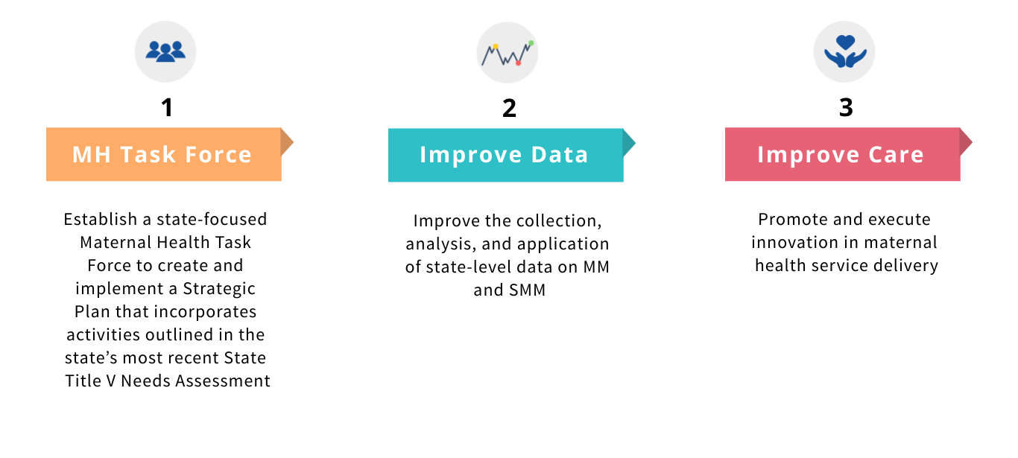
I PROMOTE-IL Project Goals

Slide 15
Goal 1: Illinois Maternal Health Task Force
Establish a State-wide Maternal Health Task Force
Consists of over 100 members representing over 30 partner organizations.
Organized into 4 strategic priority areas (committees) currently implementing version 3 of the Strategic Plan.
The task force has produced approximately 30 products. (Handout provided)
Co-Chairs of the IL Maternal Health Task Force
Lori Folken, DNP, RN, RNC-OB, C-EFM Manager, Ambulatory Women’s Health Specialties at Carle Foundation Hospital
Timika Anderson-Reeves, PhD, MSW Director of Maternal and Child Health & Women’s Health Community Integration at Access Community Health Network
Benefits of Paid Family Leave for Maternal and Child Health Fact Sheet (2023)
Decriminalizing Substance Use Disorder during Pregnancy and at Delivery in Illinois Brief (2023)
Data Use Webinars-contains materials from the March 2023 PRAMS webinar
Illinois Maternal Health Strategic Plan Versions 1-3 (2021, 2022, 2023)
Example Products:

Slide 16
Illinois Maternal Health Task Force Vision and Mission
Vision
Health equity for women, pregnant persons, and families in Illinois, across race, ethnicity, class, geography, immigration status, and ability, where we all have what they need to be healthy and reach their full potential.
Mission
To provide leadership in developing statewide strategies to reduce maternal morbidity and mortality to achieve maternal health equity by eliminating disparities and improving the overall health of women, pregnant persons, and families in Illinois.

Slide 17
Illinois Maternal Health Task Force Values
Values
The values of the Task Force describe how we work both as a group and in collaboration with stakeholders, communities, and other partners, as the Strategic Plan is created and implemented.

Slide 18
Illinois Maternal Health Task Force Priority Areas

Slide 19
Goal 2: Improve State-Level Maternal Health Data
Improve the collection, analysis, and application of state-level data on Maternal Mortality and Severe Maternal Mortality
Enhance utilization of Illinois Maternal Mortality Review Committee data
Expand and document the efforts of Severe Maternal Morbidity (SMM) Review
Increase knowledge of Task Force and other stakeholders on the Illinois landscape to reduce Severe Maternal Morbidity and Maternal Mortality
Digital Storytelling
Expanding PRAMS
County Level Profiles
Data Use Webinars
I PROMOTE-IL Special Data Projects

Slide 20
Goal 3: Improve Care Through Innovations
Five efforts to promote and execute innovation in maternal health service delivery.
Maternal Hypertension and Obstetric Hemorrhage Training for Providers
Two-Generation Approach to Postpartum Care
Birth Equity Obstetric Quality Improvement Initiative
Expansion of Psychiatric Consultation for Maternal Health Providers
Maternal Health Training for Home Visitors

Slide 21
Innovation #1: Hemorrhage & Hypertension Training for Obstetric Providers
Goal
To work with the Administrative Perinatal Centers (APCs) to ensure providers associated with all Illinois hospitals receive annual training on obstetric hemorrhage and severe hypertension.
Status
I PROMOTE-IL provides financial support to regional APCs trainings of their network hospitals and about 2,000 providers are trained each year.

Slide 22
Innovation #2: Maternal Health Training for Home Visitors
Goal
To ensure home visitors in Illinois are part of the maternal mortality solution.
Status
I PROMOTE-IL partnered with the state’s Maternal Infant and Early Childhood Home Visiting (MIECHV) program and Start Early to assess the need for maternal health education for home visiting program staff.
I PROMOTE-IL conducted 19 key informant interviews with MIECHV home visitors and supervisors about their maternal health training, with the majority reporting that they would like more information on maternal health.
I PROMOTE-IL, MIECHV, and Start Early developed content for a new training for maternal health home visitors.
The training was piloted in November 2022 and is ongoing
Goal is to have MIECHV workforce trained by end of 2023

Slide 23
Innovation #3: Expansion of Psychiatric Consultation for Maternal Health Providers
Goal
To Enhance the work of Illinois DocAssist to expand mental health training and psychiatric consultation service to obstetric providers in Illinois.
Status
I PROMOTE-IL partnered with Illinois DocAssist to expand their psychiatric training, education, and consultation services to maternal health providers across the state to address perinatal behavioral health.
Illinois DocAssist created three maternal mental health trainings for providers: Substance Use, Depression, and Anxiety

Slide 24
Innovation #4: Birth Equity Obstetric Quality Improvement Initiative
Goal
To support the Illinois Perinatal Quality Collaborative (ILPQC) to develop an initiative to improve birth equity and reduce peripartum racial/ethnic disparities.
Status
86 birthing hospitals are participating in the Birth Equity Initiative
Increased implicit bias and respectful care education for providers and nurses from 15% and 24% at baseline (July 2021) to 66% and 89% in August 2022.
Increased the number of obstetric patients receiving education about early warning signs from 28% of randomly sampled patients at baseline (July 2021) to 97% of randomly sampled patients in August 2022.
Increased the number of obstetric patients screened for Social Determinants of Health from 19% of randomly sampled patients at baseline (July 2021) to 54% of randomly sampled patients in August 2022.

Slide 25
Innovation #5: Two-Generation Approach to Postpartum Care
Goal
To develop and implement an innovative Two-Generation Approach to postpartum care at UI Health.
Status
The Two-Generation Clinic has >200 patients and 2 locations.
Postpartum mothers and their infants receive simultaneous medical care with the same provider.
All patients receive screenings to identify health, mental health, and social care needs.
Clinic offers real-time behavioral health with psychiatrists and social workers, lactation consultation, and care navigation/coordination.

Slide 26
Pritzker Housing Project

Slide 27
Pritzker Housing Project
In collaboration with the Pritzker Family Foundation, the UIC Center for Research on Women and Gender and I PROMOTE is working:
To understand and inform the full landscape of homelessness, unmet housing needs, and available housing services and resources for pregnant, postpartum and families with children under age 3 in Illinois.

Slide 28
Pritzker Housing Project
The overall goal of this project is to support the collection and analysis of data, and to coordinate with multiple organizations and key stakeholders to describe housing needs among pregnant/postpartum people and families with children under the age of three in Illinois and to understand the full landscape of homelessness and housing services and resources for this population.
Objective #1: To gather data and complete a needs assessment report on the state of homelessness and housing insecurity among pregnant and postpartum people and families with young children.
Objective #2: To collaborate with multiple Illinois housing experts to understand and map out the landscape of housing and homelessness programs/services.

Slide 29
Pritzker Housing Project
Provide a comprehensive overview of the current status of housing and homelessness supports and resources, as well as potential promising local and national programs or approaches available for pregnant/postpartum people and families with children under the age of three
Summarize the need for housing among this population using existing data sources and collect primary data; where available, Illinois-specific, and national data will be reported.
Culminate in a needs assessment summarizing existing and new data sources and describe the housing system’s infrastructure to adequately and equitably address the needs of pregnant/postpartum people and families with children under the age of three.

Slide 30
Interviews: Housing Organizations
In a series of interviews with 25 housing organizations,
Only half (n=12, 50%) of organizations interviewed have housing services or advocacy specifically for pregnant or postpartum people.
Prioritization of pregnant and postpartum persons during the housing process was identified as the most important need for establishing stable housing for this priority population (n=7, 29%).
The most mentioned recommendation for policy changes were changing eligibility criteria for accessing housing resources (n=7, 29%), and prioritizing pregnant, postpartum or families with young children in the housing applicable process (n=7, 29%).
Nearly 3 out of 4 (n=18, 75%) said that the supports and services that their organization offers doesn’t meets the housing needs of their clients.
Lack of housing that is affordable was the most mentioned barrier to stable housing (n=22, 92%).

Slide 31
Interviews: Parents
In a series of interviews with 25 parents who were homeless while pregnant,
Pregnancy was reported as the leading cause of homelessness (n=7, 28%).
The difficulty of navigating the housing system and homelessness resources was the biggest barrier to stable housing (n=21, 84%).
Violence (n=9, 36%) and concerns for safety (n=12, 48%) were frequently reported, leading to stress for all respondents. Intimate partner violence was also exacerbated by the COVID-19 pandemic stay-at-home orders.¹⁵
Notes:
15. Peitzmeier, S. M., Fedina, L., Ashwell, L., Herrenkohl, T. I., & Tolman, R. (2022). Increases in Intimate Partner Violence During COVID-19: Prevalence and Correlates. Journal of Interpersonal Violence, 37(21–22), NP20482–NP20512. https://doi.org/10.1177/08862605211052586

Slide 32
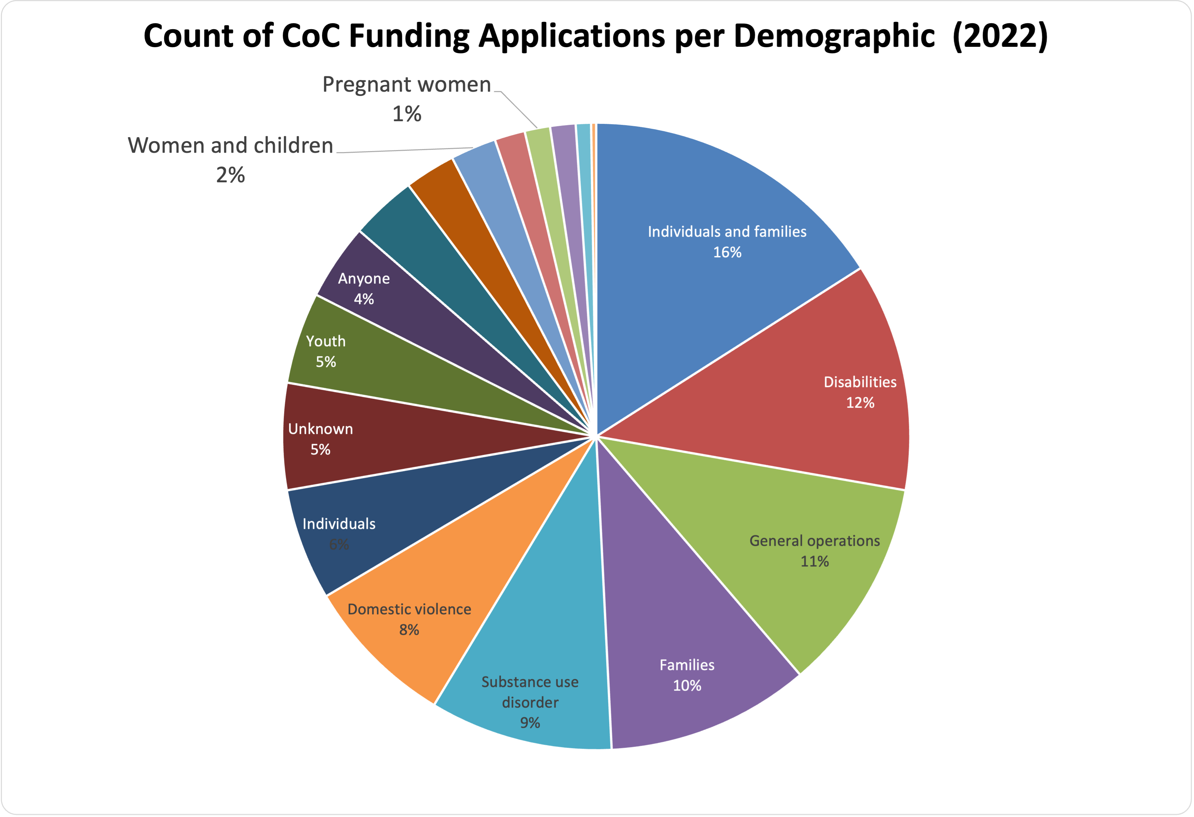
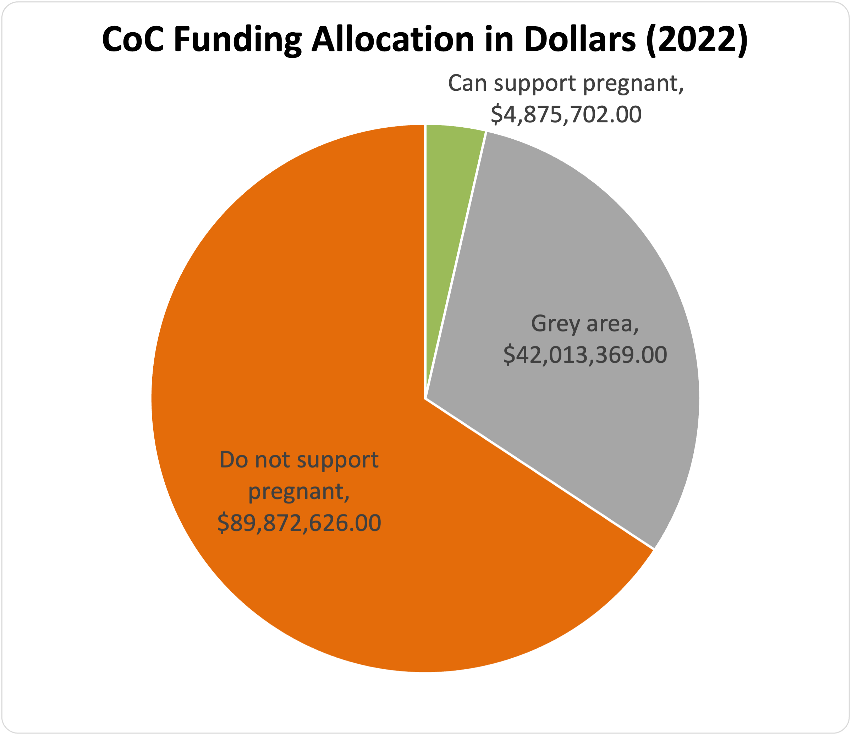
IL CoC Funding Review
Nearly $137 million were distributed among housing organizations by IL’s 19 Continuum of Care (CoC) regions
Chicago received 60.5% of these funds, Cook County 15.0%, and all other regions less than 5.0%
Of 28 organizations that support the target population, only 3 receive CoC funds

Slide 33
IL Housing Authority Prioritizations Review
In total, there are 105 housing authorities in Illinois. Each is required to file an Admissions and Continued Occupancy Policy (ACOP) on an annual basis.
Of the 45 ACOPs received, none prioritize pregnant women for housing.
However, all housing authorities count pregnant women as two people for the purposes of bedroom/unit size.
Most housing authorities purchase standard plans from consulting groups (Nan McKay, Quadel, CVR and Associates), then make minor adjustments based on local preferences.¹⁶
Notes:
16. 3 Large Public Housing Consultant Companies Managing Voucher Programs. (2017, August 1). International Observatory on Social Housing. https://internationalsocialhousing.org/2017/08/01/3-large-public-housing-consultant-companies-managing-voucher-programs/

Slide 34
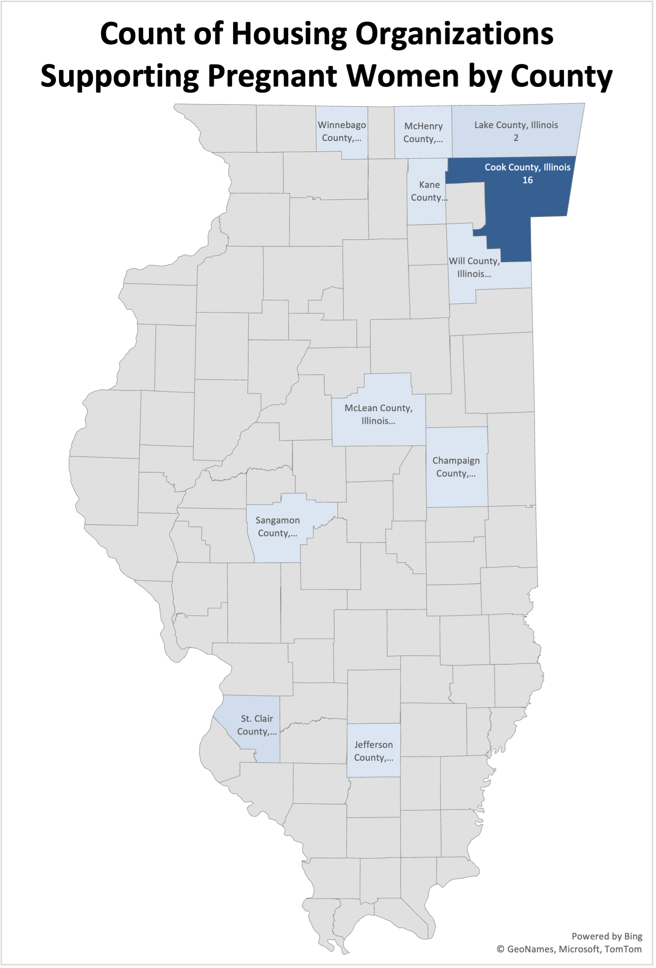
Illinois Scan: Perinatal Housing Support Organizations
Out of over 150 organizations supporting unhoused people in IL, only 28 are known to support the target population
Nationally, most organizations that support the target population are:
Limited to serving youth (18-24 years old),
Shelters and maternity homes (not transitional housing),
Restricted to housing just the mother (no additional children, partners, or family members),
Unable to house the target population into the postpartum period.

Slide 35
Perinatal Housing Support Organizations
National Scan: Perinatal Housing Support Organizations
San Francisco, CA
Since 2019, pregnant persons in SF qualify for family housing status regardless of term, and may also apply for adult/youth housing, if they prefer¹⁷
Specifically support pregnant and postpartum women
Hamilton Family Emergency Shelter
Cleveland, OH
Programs in Cleveland determine eligibility for pregnant women on a case-by-case basis
Specifically support pregnant and postpartum women
Other programs
Homeless Prenatal Program (Jelani House)
Other programs
New Creation Home Ministries
Compass Family Services
La Casa de las Madres
Riley Center (Brennan & Rosalie House)
St. Joseph’s Family Center
Zelie's House
Sisters Haven
The Mom's House (MetroHealth)
Family Promise of Greater Cleveland
The City Mission (Laura's Home)
This is the "front door shelter" for all homeless individuals and families in Cleveland
Roughly ½ of shelters and programs welcome to perinatal women specifically support them
Roughly ½ are funded primarily by government grants and the other ½ are privately funded
Transitional housing programs generally support women up to 9-12 months postpartum
Partners and other minor children are not generally allowed to cohabitate with the pregnant women
*https://www.streetsheet.org/pregnant-people-to-be-prioritized-for-shelter-and-housing/
Notes:
17. Watts, Q. (2019, November 1). Pregnant People to be Prioritized for Shelter and Housing. Street Sheet. https://www.streetsheet.org/pregnant-people-to-be-prioritized-for-shelter-and-housing/

Slide 36
National Scan: Perinatal Housing Support Policies
Pregnant Women Assistance (PWA) Program – Washington State¹⁸
Provides women who are low-income and pregnant with $363 monthly cash assistance and referral to the HEN program for 24 consecutive months
The Housing and Essential Needs (HEN) program additionally helps with rent and utility assistance, move-in costs, personal hygiene items, and transportation assistance¹⁹
Notes:
18. Pregnant Women Assistance (PWA) Program | DSHS. (n.d.). Retrieved October 12, 2023, from https://www.dshs.wa.gov/esa/community-services-offices/pregnant-women-assistance-pwa-program
19. Housing and Essential Needs (HEN) Referral Program | DSHS. (n.d.). Retrieved October 12, 2023, from https://www.dshs.wa.gov/esa/community-services-offices/housing-and-essential-needs-hen-referral-program

Slide 37
Illinois Interagency Task Force on Homelessness

Slide 38
Illinois Interagency Task Force on Homelessness
Executive Order to Fight Homelessness in Illinois – September 2021
Creation of the Interagency Task Force on Homelessness to develop a
plan by March 2022 and ongoing annual reports
Goals of the Task Force are to:
Address and achieve functional zero homelessness
Address unnecessary institutionalization
Strengthen safety nets that contribute to housing stability
Improve health outcomes for people experiencing homelessness
The Root/Structural Causes Committee is working to ensure that a representative on the Task Force promotes the importance of prioritizing pregnant/postpartum people and families with young children.
Notes:
In early September 2021, Governor Pritzker of Illinois signed an executive order that created a new homelessness infrastructure within the state government, which consists of an interagency task force on homelessness. This group is tasked with developing a plan for the Governor by March 2022 and producing annual reports in December of each year there after.
The goal of the task force is to address homelessness and ultimately achieve functional zero homelessness throughout the state, to address unnecessary institutionalization, strengthen safety nets that contribute to housing stability, and improve health outcomes for people experiencing homelessness.
The Root/Structural Causes Committee is working to ensure that a representative on the Task Force promotes the importance of prioritizing pregnant/postpartum people and families with young children.

Slide 39
Policy Suggestions
Advocate for…
Shelter-based interventions providing prenatal care⁵
Expansion of programs which provide units conducive for families (i.e., not studios or individual-sized units)
Policies that support fair and just housing, such as eliminating racist restrictive covenants in housing and property deeds²⁰
More funding for federal housing programs (National Housing Trust Fund)
Increase access to consistent preventive care⁸
Reconfigure services to be delivered in a way that recognizes and meets homeless people's complex and diverse needs⁸
Decrease fragmentation of health services
Staff training on working with homeless populations
Continue supporting or building upon legislation passed during COVID-19 pandemic (i.e., emergency rental assistance, sealing eviction records, and foreclosure moratorium)²¹
Notes:
With this in mind, we offer some policy suggestions regarding housing and maternal health. For example:
You can advocate for shelter-based interventions providing prenatal care
You can advocate for expansion of programs which provide units conducive for families
You can advocate broadly for policies that support fair and just housing and more funding more federal housing programs
You can increase access to consistent preventative care
You can work to reconfigure services to meet homeless people’s needs through decrease fragmentation and increased training
You can also support the legislation that was passed during COVID-19 to continue, including rental assistance, sealing eviction records, and foreclosure moratoriums.
5. Clark, R. E., Weinreb, L., Flahive, J. M., & Seifert, R. W. (2019). Homelessness contributes to pregnancy complications. Health Affairs, 38(1), 139-146.
20. APHA. (2018). State of the nation’s housing report: creating the healthiest nation. 50(7)2. 2018 14.
8. McGeough, C., Walsh, A., & Clyne, B. (2020). Barriers and facilitators perceived by women while homeless and pregnant in accessing antenatal and or postnatal healthcare: A qualitative evidence synthesis. Health & Social Care in the Community.
21. Housing Action Illinois (2021). Federally funded emergency rental assistance programs for 2021. Retrieved from https://housingactionil.org/blog/2021/04/19/federally-funded-emergency-rental-assistance-programs-for-2021/

Slide 40
Example Housing Programs
Example of programs focused on pregnant and postpartum populations:
Maternity Group Homes for Pregnancy and Parenting Youth Program (ages 16-22, funded by Health and Human Services (HHS), FYSB)²²
IL is not a current recipient of this grant
Boston Public Health Commission & Boston Housing Authority’s Healthy Start in Housing (HSiH) helps high and at-risk pregnant women secure and retain stable housing to improve health outcomes²³
Intensive case management
Family goal creation and coaching
Notes:
Overall, pregnant and postpartum people have not been prioritized in housing policies or services. However, there are some examples of programs or policies that have focused on the pregnant and postpartum population:
1. Maternity Group Homes for pregnancy and parenting youth for people aged 16-22, though this was not funded in IL
2. The Boston Housing Authority created a Healthy Start in Housing program to help high and at-risk pregnant people secure and retain stable housing
Though these programs are great, there is not any state or national policy that entitles housing options to pregnant and postpartum people.
22. U.S. Department of Health and Human Services (HHS). (2019). FYSB FY2019 Runaway and homeless youth maternity group homes grantees. Retrieved from https://www.acf.hhs.gov/fysb/grant-funding/fysb-fy2019-runaway-and-homeless-youth-maternity-group-homes-grantees
23. Boston Housing Authority (2014). Health Start in Housing provides housing and services to women with high risk pregnancies. Retrieved from https://www.bostonhousing.org/en/BHA-Blog/December-2014/Healthy-Start-in-Housing-provides-housing-and-serv.aspx#:~:text=The%20Boston%20Public%20Health%20Commission,secure%20and%20retain%20stable%20housing

Slide 41
Example Housing Program: HBAH
Healthy Beginnings at Home (HBAH) is a research project in Columbus, Ohio which tested the impact of providing 21-24 months of rental assistance and housing stabilization services to unstably housed pregnant women at risk of infant mortality^{24,25}
Compared to providing the usual care services, those who were also provided with rental assistance and housing stabilization services were:
More likely* to have babies born full-term at a healthy weight
Have a lower average amount of Medicaid claims ($4,175 average vs $21,521 average)
HBAH improved housing stability: 35% stably housed and 37% were stably housed with some concerns at the end of HBAH
After enrollment, took an average of 62 days to secure housing due to limited affordable options
*not statistically significant
Notes:
3. Healthy Beginnings at Home (HBAH) is a research project in Columbus, Ohio which tested the impact of providing rental assistance with housing stabilization services to unstably housed pregnant women at risk of infant mortality.
HBAH participants formed strong relationships with their housing stability specialist
Racism, trauma and violence must be addressed
HBAH families faced substantial economic challenges that were exacerbated by the COVID-19 pandemic
24. Health Policy Institute of Ohio. (June 2021). Healthy Beginnings at Home: Final Report. Retrieved from
https://cohhio.org/healthy-beginnings-at-home/research-and-reports/
25. Bush Stevens, Reat, and Santiago. (June 2023). Healthy Beginnings at Home: Final Report. Retrieved from https://www.healthpolicyohio.org/healthy-beginnings-at-home-final-report/

Slide 42
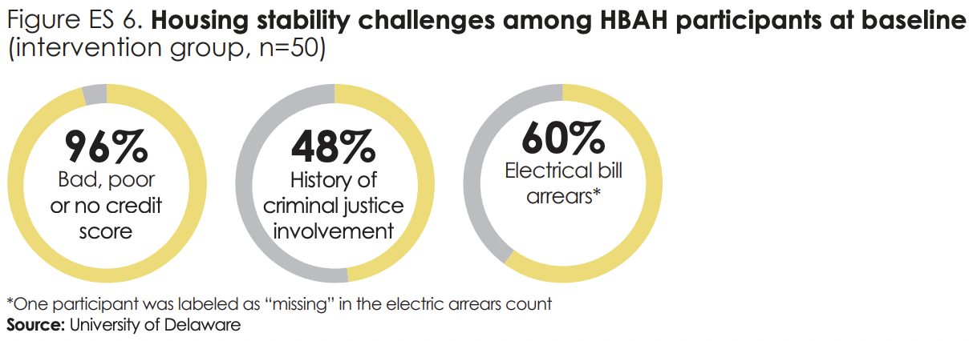
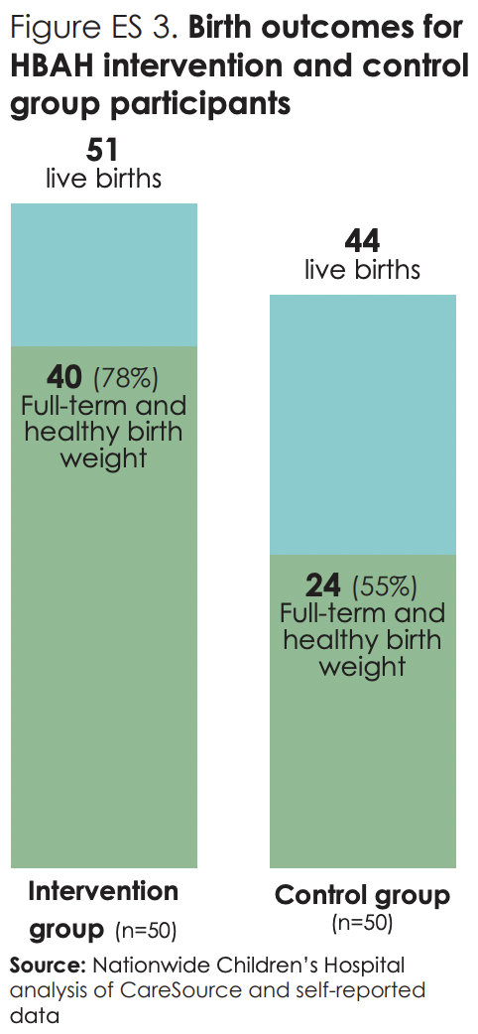
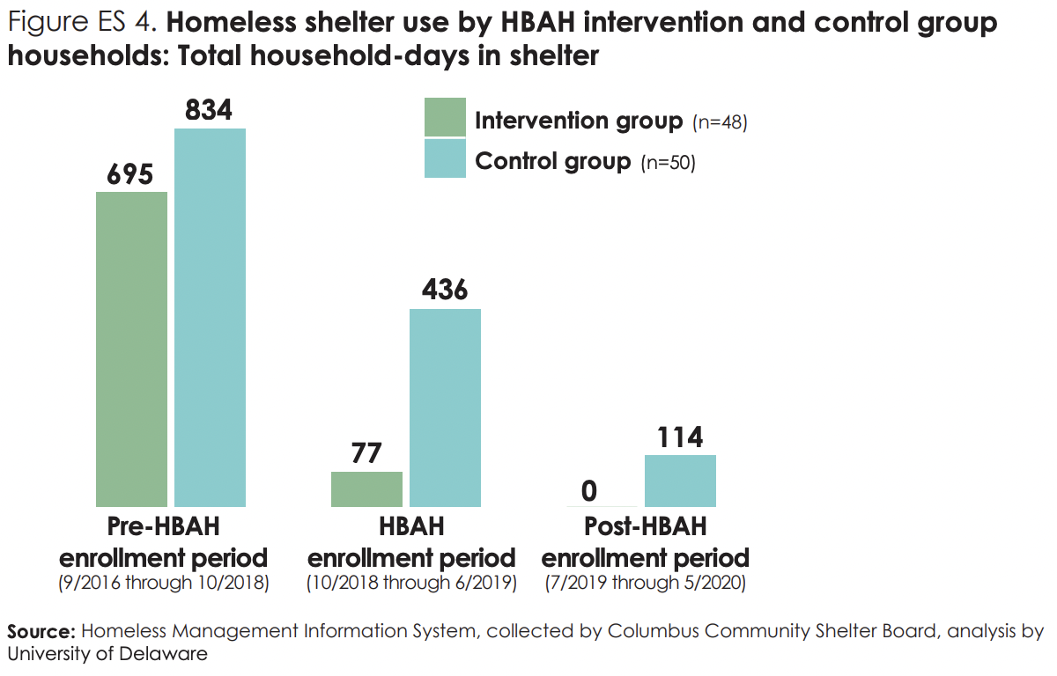
Example Housing Program: HBAH
Housing instability has a number of causes.
Ongoing rental assistance and intensive housing stabilization services can:
Improve birth outcomes for high risk families
Reduce homeless shelter use for these families
Notes:
3. Healthy Beginnings at Home (HBAH) is a research project in Columbus, Ohio which tested the impact of providing rental assistance with housing stabilization services to unstably housed pregnant women at risk of infant mortality.
24. Health Policy Institute of Ohio. (June 2021). Healthy Beginnings at Home: Final Report. Retrieved from
https://cohhio.org/healthy-beginnings-at-home/research-and-reports/

Slide 43
HBAH Policy Suggestions²⁵
Prioritize communities with high rates of infant mortality and racial disparities
Provide targeted rental and utilities assistance to pregnant women at high risk of infant mortality (e.g., Housing Choice Vouchers)
Implement housing stability services into healthcare and social services
Increase the supply of quality, affordable housing and streamline the approval process of housing development
Increase the number of property owners willing to rent to families with low-income
Increase access to jobs with self-sufficient wages
Strengthen childcare subsidies to promote ability to afford childcare
Reduce legal barriers that prevent people with criminal records from getting jobs
Strengthen access to public transportation
Promote opportunities for educational attainment and workforce development to help extremely low-income households
Expand Medicaid coverage to 12 months postpartum
Notes:
See report for specific examples of each
25. Bush Stevens, Reat, and Santiago. (June 2023). Healthy Beginnings at Home: Final Report. Retrieved from https://www.healthpolicyohio.org/healthy-beginnings-at-home-final-report/

Slide 44
Policy Suggestions
Housing cannot be addressed in isolation. Must also work to ensure community safety and economic stability, including:
Institutional policies promoting and enforcing screening in health care systems²⁶
Substance use disorders, mental health, safe housing, intimate partner violence
Funding to provide victim assistance & housing to support
pregnant/postpartum women needing to leave violent intimate
partners
Social policies to support the education and employment of
women & provide adequate day care for working parents
Paid Family Leave
Notes:
Therefore, it is important to note that housing cannot be addressed in isolation and other work to ensure safety and economic stability are necessary. This includes:
Having institutional policies for health screenings (IPV< mental health, etc.)
Funding for pregnant and postpartum victims of IPV
Social policies to support education and employment of women
Adequate and affordable day care
Paid family leave
26. Sharps PW, Laughon K, Giangrande SK. Intimate partner violence and the childbearing year: maternal and infant health consequences. Trauma Violence Abuse. 2007;8:105e116.

Slide 45
Recommendations for federal and state-wide initiatives

Slide 46
Medicaid Limitations
Currently, Medicaid, covers 42% of pregnancies nationwide and is the top insurer of pregnant people and most unhoused people.²⁷
Medicaid cannot be used to directly cover housing costs for its customers, but it can be used to provide:²⁸
Behavioral health and personal care services
Case management, housing transition services, and linkage to community-based organizations
Strategic and collaborative activities to assist states in identifying housing resources within the community
This strategy is being implemented by the Wisconsin DHS²⁹
Notes:
Under the current HUD definition of chronic homelessness an individual or family must meet one of three criteria of homelessness.2 The first criterion is that an individual with a disability is living in a location not meant for human habitation, a safe haven, or an emergency shelter and has been living as described for at least 12 months or on at least four separate occasions in the last three years.24 The combined occasions must equal at least 12 months and each break must have included at least seven consecutive nights not living as described.24 The second criterion is an individual living in an institutional care facility for less than 90 days and met all criteria of the definition prior to entering the institutional care facility.24 An institutional care facility includes jail, substance abuse or mental health treatment facilities, or other similar facilities.24 The third criterion is that, within a family, the head of household meets all criteria in the definition.
27. Gomez, I., Ranji, U., Salganicoff, A., & Published, B. F. (2022, February 17). Medicaid Coverage for Women. KFF. https://www.kff.org/womens-health-policy/issue-brief/medicaid-coverage-for-women/
28. Evaluation (ASPE), A. S. for P. and. (2007, September 26). Condensed Version of a Primer on How to Use Medicaid to Assist Persons Who Are Homeless to Access Medical, Behavioral Health, and Support Services [Text]. HHS.Gov. https://www.hhs.gov/programs/social-services/homelessness/research/how-to-use-medicaid-to-assist-homeless-persons/index.html
29. Housing Support Services Health Services Initiative. (2021, October 12). Wisconsin Department of Health Services. https://www.dhs.wisconsin.gov/medicaid/housing-supports.htm

Slide 47
Federally Funded and Monitored Programs
Department of Housing and Urban Development (HUD) Continuum of Cares (CoCs)³⁰
Description
As of 2023, Illinois has 19 CoCs.
Each CoC operates independently to promote goal of ending homelessness.
CoCs quickly rehouse individuals, families, youth, and persons fleeing domestic violence.
Programs within CoCs
Joint Transitional Housing/Permanent Housing – Rapid Rehousing: provides transitional housing with financial services and wrap around supportive services.
Domestic Violence and Human Trafficking Rapid Rehousing Programs
Prioritization
Determined by HUD, which encourages the prioritization of those experiencing chronic homelessness.
CoCs can set prioritizations within subpopulations through community data or experiences.
Data and Evaluation
HUD system-level performance measures are generated through the Homelessness Management Information System (HMIS).
System-level performance measures include: length of homelessness, rate of exit to permanent housing, rate of income from employment, and rate of return to homelessness once housed.
Notes:
Under the current HUD definition of chronic homelessness an individual or family must meet one of three criteria of homelessness. The first criterion is that an individual with a disability is living in a location not meant for human habitation, a safe haven, or an emergency shelter and has been living as described for at least 12 months or on at least four separate occasions in the last three years. The combined occasions must equal at least 12 months and each break must have included at least seven consecutive nights not living as described. The second criterion is an individual living in an institutional care facility for less than 90 days and met all criteria of the definition prior to entering the institutional care facility. An institutional care facility includes jail, substance abuse or mental health treatment facilities, or other similar facilities. The third criterion is that, within a family, the head of household meets all criteria in the definition.
30. Continuum of care program. U.S. Department of Housing and Urban Development Web site.
https://www.hud.gov/program_offices/comm_planning/coc. Updated 2023. Accessed March 25th, 2023.

Slide 48
Federally Funded and Monitored Programs
Public Housing Authorities and Multifamily Development Units³¹⁻³³
Description
Public Housing Authorities
As of 2023, Illinois has 106 PHAs.
Funding comes from Congressional appropriations.
Congress and HUD establish rules that PHAs must follow. Local PHAs have flexibility to adopt local policies and procedures, as long as they don’t conflict with federal rules and regulations established.
House Choice Voucher (HCV) programs
Individuals apply for rental assistance to privately owned homes through their local PHA. The PHA then calculates housing assistance so that the tenant’s rent is equal to 30% of a household’s adjusted monthly income.
Local PHAs can apply to HUD for Special Purpose Vouchers, which serve a specific population. The Special Purpose Vouchers are determined by policy goals, research, and data.
Multifamily Development Units provide various lending products (e.g. credit, loans, mortgages) to private developers to expand affordable housing.
Prioritization
PHAs have no preference for and no mechanism to prioritize pregnant/postpartum people and families with young children.
The Family Unification Program Vouchers, a Housing Choice Voucher Program, addressing child welfare involvement.
Data and Evaluation
PHA waiting lists are long, seldom open, and have no preference for pregnant/postpartum people and families with young children.
Waiting lists are updated annually.
Notes:
31. Definition of chronic homelessness . HUD Exchange Web site.
https://www.hudexchange.info/homelessness-assistance/coc-esg-virtual-binders/coc-esg-homeless-
eligibility/definition-of-chronic-homelessness/. Accessed 5/9/, 2023.
32. Public housing (PH) data dashboard. U.S. Department of Housing and Urban Development Web site.
https://www.hud.gov/program_offices/public_indian_housing/programs/ph/PH_Dashboard. Accessed
April 25, 2023.
33. Public housing. National Housing Law Project Web site. https://www.nhlp.org/resource-center/public-
housing/. Accessed May 10th, 2023.

Slide 49
Federally Funded and Monitored Programs
Maternity Group Homes for Pregnant and Parenting Youth (MGH) Program³⁴
Federally funded by HHS under the Runaway Homeless Youth Act (1974)
Youth age 16-22 are eligible
Extends residential shelter and helps youth transition to permanent living
Provides funding to teach basic life skills for parenting, money management, and job attainment
Notes:
34. Maternity Group Homes. (n.d.). Retrieved October 12, 2023, from https://www.acf.hhs.gov/fysb/fact-sheet/maternity-group-homes

Slide 50
State Funded Programs
The Illinois Housing Development Authority (IHDA)³⁵⁻³⁷
Description
Creates an annual affordable housing plan and reports on progress made to the Governor. The annual plan reflects the priorities of various state agencies and priority populations with specific housing and services.
Program within IHDA: Rental Housing Support Programs (RHSP)
Subsidizes rental apartments and housing through a $10 fee on real estate recording deeds.
Landlords apply to the RHSP to make existing units affordable.
The majority of RHSPs are managed by a local nonprofit or governmental agency.
Notes:
35. Rental housing resources. Illinois Housing Development Authority Web site.
https://www.ihda.org/rental-housing-main/rental-housing/. Accessed April 25, 2023.
36. Rental housing support (RHS) program re-entry special demonstration program local administering
agencies (LAA). Illinois Housing Development Authority. 2018.
37. Request for proposals - rental housing support program special demonstration program local
administering agencies. Illinois Housing Development Authority. 2017.

Slide 51
State Funded Programs
The Department of Children and Family Services (DCFS)
Program within DCFS: Housing Advocacy and Cash Assistance Programs (NORMAN)³⁸
Provides cash assistance to prevent the separation of families or promote the reunification of families when there are issues of housing, food, or clothing.
Nonprofit organizations complete assessments and distribute temporary cash assistance.
Program within DCFS: Youth Housing Advocacy and Cash Assistance³⁹
Helps youth that are transitioning out of being wards of the state find permanent and adequate housing through advocacy and cash assistance.
Notes:
38. Housing advocacy and cash assistance program . National Low Income Housing Coalition Web site. https://reports.nlihc.org/rental-programs/catalog/housing-advocacy-and-cash-assistance-program. Accessed 7/3/, 2023.
39. Youth housing assistance program. Illinois Department of Children and Family Services Web site. https://dcfs.illinois.gov/brighter-futures/independence/housing/cash-assistance.html. Accessed 7/3/, 2023.

Slide 52
State Funded Programs
Homeless Prevention Program⁴⁰
Funding is distributed by CoCs.
2023 funding: $26 million.
Provides rental/mortgage assistance, utility assistance, approved case management, and approved supportive services to individuals and families who have been given a 5-day notice of late rent, are in the eviction or foreclosure process, or are currently houseless with the ability to enter housing with one-time financial assistance.
Those receiving the assistance must document a temporary economic crisis beyond their control and must be able to demonstrate that they can meet prospective rental/utility obligations after the assistance has been granted based on current or anticipated income.
Notes:
40. Homeless prevention. Illinois Department of Human Services Web site.
https://www.dhs.state.il.us/page.aspx?item=30360. Accessed April 25, 2023.

Slide 53
State-wide and Local Initiatives
Low-Income Home Energy Assistance Program (LIHEAP)⁴¹
State-wide initiative
Helps eligible low-income households pay for home energy services
Similar assistance is available for water and wastewater bills.
Utility Relief Program⁴²
Chicago initiative
Offers a 50% reduction of the water rate, sewer rate, and water-sewer tax on residents’ utility bills.
Offers the opportunity for compete debt forgiveness on Chicago utility accounts.
Notes:
41. Utility bill assistance. Illinois Department of Commerce Web site.
https://dceo.illinois.gov/communityservices/utilitybillassistance.html. Accessed 5/10/2023.
42. Utility billing relief program & LIHWAP . City of Chicago Web site.
https://www.chicago.gov/city/en/depts/fin/provdrs/utility_billing/svcs/utility-bill-relief-program.html.
Accessed 5/10/, 2023

Slide 54
Federal Initiatives
Environmental Justice Toolkit for Lead Paint Enforcement Programs⁴³
More than 34 million homes in the U.S. have lead paint somewhere in the building.
This toolkit offers strategies for governments and communities to remove lead paint from homes with a focus on overburdened communities.
In Chicago, the EPA and DOJ settled with Logan Square Aluminum Supply over lead violations that “includes $2 million of lead-based paint abatement work in lower-income properties.”⁴⁴
Notes:
43. Environmental Protection Agency. (June 2023). Environmental Justice Toolkit for Lead Paint Enforcement Programs. https://www.epa.gov/system/files/documents/2023-07/ejleadpainttoolkit.pdf
44. EPA Press Office. (2023, January 30). EPA and DOJ Announce Settlement with Logan Square Aluminium Supply Over Lead Violations [News Release]. https://www.epa.gov/newsreleases/epa-and-doj-announce-settlement-logan-square-aluminium-supply-over-lead-violations

Slide 55
Federal Initiatives
Social Determinants for Moms Act^{45*}
The first bill included in the Black Maternal Health Momnibus Act⁴⁶, which aims to address Black maternal mortality and morbidity with an extension of comprehensive supports and quality metrics.
This bill will “make critical investments in social determinants of health that influence maternal health outcomes,” including housing.
Innovative Maternal Payment and Coverage to (IMPACT To) Save Moms Act^{47*}
“Establishes a new Center for Medicare and Medicaid Services Innovation Center demonstration project to transform maternity care delivery.”
Would make investments in social determinants of health, such as housing.
*Unpassed legislation
Notes:
45. Hayes Leads Legislation to Address Maternal Health Crisis and Save Mothers and Infants. (2023, May 16). Congresswoman Jahana Hayes. https://hayes.house.gov/2023/5/hayes-leads-legislation-to-address-maternal-health-crisis-and-save-mothers-and-infants
46. Black Maternal Health Momnibus | Black Maternal Health Caucus. (2020, March 7). http://blackmaternalhealthcaucus-underwood.house.gov/Momnibus
47. Schakowsky Reintroduces Legislation to Address Black Maternal Health Disparities | Congresswoman Jan Schakowsky. (2023, May 15). http://schakowsky.house.gov/media/press-releases/schakowsky-reintroduces-legislation-address-black-maternal-health-disparities

Slide 56
Recommendations for
State-Wide Initiatives
Create initiatives/programs for pregnant persons
IHDA and Local Administering Agencies can create Special Demonstration Programs under their Rental Housing Support Programs
Improve central databases and data collection
Create a centralized database of resources and tracking of people utilizing the services
All state and local level resources should collect information on pregnancy, postpartum status, and number and age of children
IDHS can create a specific resource or goals for access by referrals from maternal healthcare providers for our population
Set aside housing for pregnant persons

Slide 57
Summary
Housing is essential to promote the health of pregnant people and their babies throughout the perinatal period.
The I PROMOTE-IL team is working on interdisciplinary solutions to address the maternal health crisis.
The Pritzker Housing Project is exploring policy solutions to improve homelessness services specifically for pregnant people.
Governmental and nonprofit organizational policy should prioritize pregnant women for housing.

Slide 58
References
Centers for Disease Control and Prevention (2021). Social Determinants of Health: Know What Affects Health. https://www.cdc.gov/socialdeterminants/index.htm.
Reece J. (2021). More Than Shelter: Housing for Urban Maternal and Infant Health. International journal of environmental research and public health, 18(7), 3331. https://doi.org/10.3390/ijerph18073331
Illinois MMRC and MMRC-V Data, 2016-2017.
Illinois Maternal Morbidity and Mortality Report, Illinois Department of Public Health. (October 2023).
Clark, R. E., Weinreb, L., Flahive, J. M., & Seifert, R. W. (2019). Homelessness contributes to pregnancy complications. Health Affairs, 38(1), 139-146.
Green, J. M., Fabricant, S. P., Duval, C. J., et al. (2023). Trends in maternal morbidity associated with unhoused status in pregnancy, 6(7). doi:10.1001/jamanetworkopen.2023.26352
Dworsky, A., Morton, M. H. & Samuels, G. M. (2018). Missed opportunities: Pregnant and parenting youth experiencing homelessness in America. Chicago, IL: Chapin Hall at the University of Chicago.
McGeough, C., Walsh, A., & Clyne, B. (2020). Barriers and facilitators perceived by women while homeless and pregnant in accessing antenatal and or postnatal healthcare: A qualitative evidence synthesis. Health & Social Care in the Community.
Lewis, J. H., . Andersen, R. M., & Gelberg, L. (2003). Health care for homeless women: Unmet needs and barriers to
care. Journal of general internal medicine, 18(11), 921-928.

Slide 59
Cutts, D. B., Coleman, S., Black, M. M., Chilton, M. M., Cook, J. T., de Cuba, S. E., ... & Frank, D. A. (2015). Homelessness during pregnancy: a unique, time-dependent risk factor of birth outcomes. Maternal and child health journal, 19(6), 1276-1283
Himmelstein MA and Desmond, M. Association of eviction with adverse birth outcomes among women in Georgia, 2000 to 2016. JAMA Pediatrics. 2021.
Rittman, D., Parrish, J., & Lanier, P. (2020). Prebirth Household Challenges To Predict Adverse Childhood Experiences Score by Age 3. Pediatrics, 146(5), e20201303. https://doi.org/10.1542/peds.2020-1303
Joint Center for Housing Studies of Harvard University. (2023). State of the nation’s housing 2023. https://www.jchs.harvard.edu/sites/default/files/reports/files/Harvard_JCHS_The_State_of_the_Nations_Housing_2023.pdf
Leifheit, K. M., Schwartz, G. L., Pollack, C. E., Edin, K. J., Black, M. M., Jennings, J. M., & Althoff, K. N. (2020). Severe Housing Insecurity during Pregnancy: Association with Adverse Birth and Infant Outcomes. International journal of environmental research and public health, 17(22), 8659. https://doi.org/10.3390/ijerph17228659
Peitzmeier, S. M., Fedina, L., Ashwell, L., Herrenkohl, T. I., & Tolman, R. (2022). Increases in Intimate Partner Violence During COVID-19: Prevalence and Correlates. Journal of Interpersonal Violence, 37(21–22), NP20482–NP20512. https://doi.org/10.1177/08862605211052586
3 Large Public Housing Consultant Companies Managing Voucher Programs. (2017, August 1). International Observatory on Social Housing. https://internationalsocialhousing.org/2017/08/01/3-large-public-housing-consultant-companies-managing-voucher-programs/
Watts, Q. (2019, November 1). Pregnant People to be Prioritized for Shelter and Housing. Street Sheet. https://www.streetsheet.org/pregnant-people-to-be-prioritized-for-shelter-and-housing/

Slide 60
Pregnant Women Assistance (PWA) Program | DSHS. (n.d.). Retrieved October 12, 2023, from https://www.dshs.wa.gov/esa/community-services-offices/pregnant-women-assistance-pwa-program
Housing and Essential Needs (HEN) Referral Program | DSHS. (n.d.). Retrieved October 12, 2023, from https://www.dshs.wa.gov/esa/community-services-offices/housing-and-essential-needs-hen-referral-program
APHA. (2018). State of the nation’s housing report: creating the healthiest nation. 50(7)2. 2018 14.
Housing Action Illinois (2021). Federally funded emergency rental assistance programs for 2021. https://housingactionil.org/blog/2021/04/19/federally-funded-emergency-rental-assistance-programs-for-2021/
U.S. Department of Health and Human Services (HHS). (2019). FYSB FY2019 Runaway and homeless youth maternity group homes grantees. https://www.acf.hhs.gov/fysb/grant-funding/fysb-fy2019-runaway-and-homeless-youth-maternity-group-homes-grantees
Boston Housing Authority (2014). Health Start in Housing provides housing and services to women with high risk pregnancies. https://www.bostonhousing.org/en/BHA-Blog/December-2014/Healthy-Start-in-Housing-provides-housing-and-serv.aspx#:~:text=The%20Boston%20Public%20Health%20Commission,secure%20and%20retain%20stable%20housing
Health Policy Institute of Ohio. (June 2021). Healthy Beginnings at Home: Final Report. https://cohhio.org/healthy-beginnings-at-home/research-and-reports/
Bush Stevens, Reat, and Santiago. (June 2023). Healthy Beginnings at Home: Final Report. https://www.healthpolicyohio.org/healthy-beginnings-at-home-final-report/
Sharps PW, Laughon K, Giangrande SK. Intimate partner violence and the childbearing year: maternal and infant health consequences. Trauma Violence Abuse. 2007;8:105e116.
Gomez, I., Ranji, U., Salganicoff, A., & Published, B. F. (2022, February 17). Medicaid Coverage for Women. KFF. https://www.kff.org/womens-health-policy/issue-brief/medicaid-coverage-for-women/

Slide 61
Evaluation (ASPE), A. S. for P. and. (2007, September 26). Condensed Version of a Primer on How to Use Medicaid to Assist Persons Who Are Homeless to Access Medical, Behavioral Health, and Support Services [Text]. HHS.Gov. https://www.hhs.gov/programs/social-services/homelessness/research/how-to-use-medicaid-to-assist-homeless-persons/index.html
Housing Support Services Health Services Initiative. (2021, October 12). Wisconsin Department of Health Services. https://www.dhs.wisconsin.gov/medicaid/housing-supports.htm
Continuum of care program. U.S. Department of Housing and Urban Development Web site. https://www.hud.gov/program_offices/comm_planning/coc. Updated 2023. Accessed March 25th, 2023.
Definition of chronic homelessness . HUD Exchange Web site. https://www.hudexchange.info/homelessness-assistance/coc-esg-virtual-binders/coc-esg-homeless-eligibility/definition-of-chronic-homelessness/. Accessed 5/9/, 2023.
Public housing (PH) data dashboard. U.S. Department of Housing and Urban Development Web site. https://www.hud.gov/program_offices/public_indian_housing/programs/ph/PH_Dashboard. Accessed April 25, 2023.
Public housing. National Housing Law Project Web site. https://www.nhlp.org/resource-center/public-housing/. Accessed May 10th, 2023.
Maternity Group Homes. (n.d.). Retrieved October 12, 2023, from https://www.acf.hhs.gov/fysb/fact-sheet/maternity-group-homes
Rental Housing Resources – IHDA. (n.d.). Retrieved October 12, 2023, from https://www.ihda.org/rental-housing-main/rental-housing/

Slide 62
Rental housing support (RHS) program re-entry special demonstration program local administering agencies (LAA). Illinois Housing Development Authority. 2018.
Request for proposals - rental housing support program special demonstration program local administering agencies. Illinois Housing Development Authority. 2017.
Housing advocacy and cash assistance program . National Low Income Housing Coalition Web site. https://reports.nlihc.org/rental-programs/catalog/housing-advocacy-and-cash-assistance-program. Accessed 7/3/, 2023.
Youth housing assistance program. Illinois Department of Children and Family Services Web site. https://dcfs.illinois.gov/brighter-futures/independence/housing/cash-assistance.html. Accessed 7/3/, 2023.
Homeless prevention. Illinois Department of Human Services Web site. https://www.dhs.state.il.us/page.aspx?item=30360. Accessed April 25, 2023.
Utility bill assistance. Illinois Department of Commerce Web site. https://dceo.illinois.gov/communityservices/utilitybillassistance.html. Accessed 5/10/2023.
Utility billing relief program & LIHWAP . City of Chicago Web site. https://www.chicago.gov/city/en/depts/fin/provdrs/utility_billing/svcs/utility-bill-relief-program.html. Accessed 5/10/, 2023
Environmental Protection Agency. (June 2023). Environmental Justice Toolkit for Lead Paint Enforcement Programs. https://www.epa.gov/system/files/documents/2023-07/ejleadpainttoolkit.pdf
EPA Press Office. (2023, January 30). EPA and DOJ Announce Settlement with Logan Square Aluminium Supply Over Lead Violations [News Release]. https://www.epa.gov/newsreleases/epa-and-doj-announce-settlement-logan-square-aluminium-supply-over-lead-violations

Slide 63
Hayes Leads Legislation to Address Maternal Health Crisis and Save Mothers and Infants. (2023, May 16). Congresswoman Jahana Hayes. https://hayes.house.gov/2023/5/hayes-leads-legislation-to-address-maternal-health-crisis-and-save-mothers-and-infants
Black Maternal Health Momnibus | Black Maternal Health Caucus. (2020, March 7). http://blackmaternalhealthcaucus-underwood.house.gov/Momnibus
Schakowsky Reintroduces Legislation to Address Black Maternal Health Disparities | Congresswoman Jan Schakowsky. (2023, May 15). http://schakowsky.house.gov/media/press-releases/schakowsky-reintroduces-legislation-address-black-maternal-health-disparities

