Slide 1
HealthChoice Illinois ADT
Illinois Primary Health Care Association &
Alliance of Chicago
PTECH Objective 5: Interoperable Data Exchange and Integration
July 13, 2023

Slide 2
Agenda
Introductions
Dana Wilson, HFS, Division of Medical Programs, Program & Policy
Coordination, Federal Health Information Planning
Nancy Sehy, BSN, RN, CHPCA, Clinical Solutions Lead, PointClickCare (formerly known as Collective Medical Technologies)
HealthChoice Illinois ADT Program Overview
Portal Capabilities & Demonstration
How to Connect (Portal Access, EMR Integration, or Both)
Q & A

Slide 3
HealthChoice Illinois ADT Program Overview

Slide 4
HFS HealthChoice Illinois ADT Program Goals
Improve Care Coordination • Utilize Reporting and Data Analysis
Provide real-time ADT alerts for immediate action events
Reduce hospital readmissions
Support Managed Care Organizations (MCOs) operations and
care coordination
Enhance provider-to-provider communication using HL7 data
Analyze equity and address disparities in healthcare
Analyze social determinants of health (SDoH)
Improve claims reporting and identify system inefficiencies
Combine HL7 data with existing claims data for insights
Enhance Data Quality
Support Interoperability Legislation
Follow HL7 and USCDI standards for data exchange
Establish state agency HL7 standards for consistency and improved exchange
Achieve a data quality verification rate of 90% or above
Support CMS Conditions of Participation requirements
Assist agencies and providers in meeting federal interoperability requirements
Collaborate with other state agencies to meet public health legislation requirements

Slide 5
Connected Facilities
925 Medicaid Facilities Transmitting Data
HealthChoice Illinois ADT Portal
Collective Medical Technologies
ED and Inpatient Care
Type | Sending Live Data
Hospitals | 194
ICFDD (Intermediate Care Facility/Developmental Disabilities) | 12
SLF (Supportive Living Facilities) | 90
SMHRF (Specialized Mental Health Rehabilitation Facilities) | 18
SNF (Nursing Facilities) | 611
Primary Care and Specialists
ACO
Behavioral Health/SUD
Community- Based Organizations
Numbers as of June 28, 2022
66 Medicaid Ambulatory & Community Providers
Ambulatory Type | Patient Rosters | Patient Population
Clinics | 45 | 410,900
Home Health | 21 | 23,650
Post-Acute
Care
Dialysis, Ancillaries
Government and Payers
Numbers as of June 28, 2023

Slide 6
PTECH Objective 5: Interoperable Data Exchange and Integration
Objective 5 of the PTECH initiative focuses on achieving seamless and secure data exchange in healthcare.
Interoperable data exchange enables sharing of health information across different platforms, organizations, and care settings.
Federally Qualified Health Centers (FQHCs) benefit greatly from interoperable
data exchange to enhance care coordination and improve patient outcomes.

Slide 7
Benefits of HealthChoice Illinois ADT Program for FQHCs
Seamless communication with hospitals, specialists, and community organizations.
Enhanced care transitions and reduced gaps in information exchange.
Efficient sharing of patient data, leading to better decision-making and patient outcomes.
Accessing real-time notifications through the HealthChoice Illinois ADT/PointClickCare Platform
Option of a direct data feed to your facilities Electronic Health Record System
Benefits of Care Insight Creation

Slide 8
Project Timeline
2021
May – Sep Hospital Onboarding
Jul – Dec Long Term Care Onboarding
Dec – All MCO’s connected
May 11, 2023
Aug 3, 2023
Clinical Collaborative Group &
Technical Advisory Group
Mar 9, 2023
Clinical Collaborative Group
May 4, 2023
Clinical Collaborative Group
HFS HealthChoice Illinois ADT Technical Advisory Committee
Convene
2023 - 2031
Data Quality
and Analytics Enhancements
2023 - 2031
Initiatives, Incentives, Programs, Increase Efficiency, Improve Patient Outcomes
Jan 2022
1st Clinical Collaborative Group (CCG)
Feb 2022
Begin Ambulatory & Community Provider Implementation
Mar 2023
1st Healthcare Transformation Collaborative
Jul 2023
Provider Notice Data Quality
Summer 2023 ADT Data Enterprise Data Warehouse
Nov 2, 2023
Clinical Collaborative Group
2023 - 2031
Phase 2:
CCDs, Labs, Imaging, Rx, Scheduling, Physician Notes, Billing Data
CCGs held each qtr. for Hospitals, MCO, LTC, and Ambulatory & Community Providers

Slide 9
PCC Ambulatory Solution Offering

Slide 10
Eliminating Silos Across Care Settings
Public Health
CCRC
Hospitals
Skilled Nursing
Diagnostics
Pharma/Life Sciences
Pharmacy
ACO
Senior Living
FQHC

Slide 11
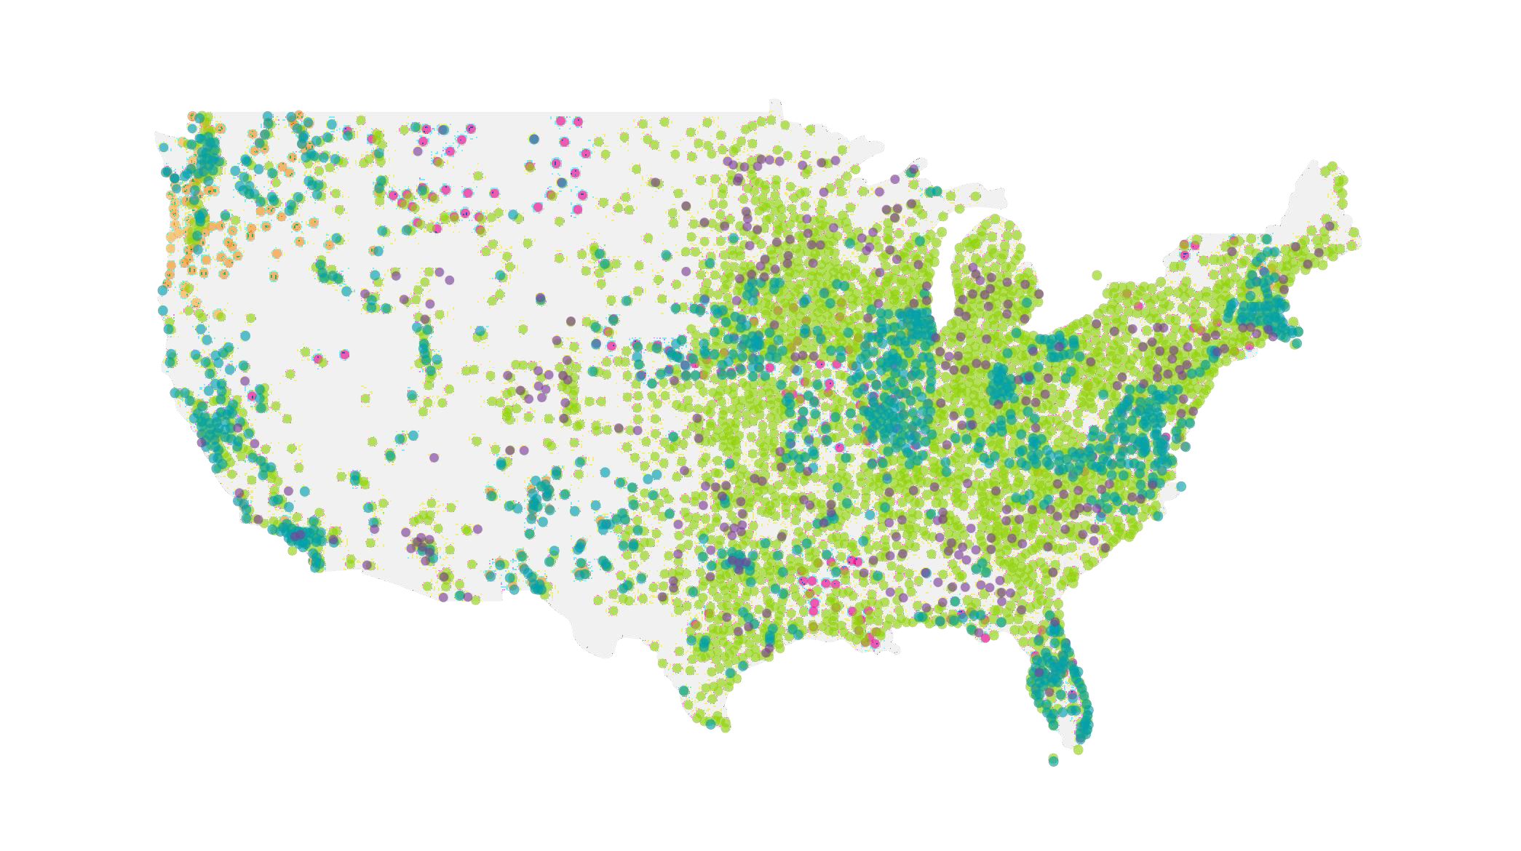
Market-Leading Long Term Care EHR + the Most Expansive Care Collaboration Network
27,000+ | LTC Care facilities
3,100+ | Hospitals and Health Systems
2,200+ | Ambulatory
45% | US Hospitals
75+ | State & Govt. Agencies
2M+ | Patient Records
195M+ | Lives
700M+ | Network Patient Visits
47 | States Connected on the Network
Every | Major US Plan
PointClickCare SNF EHR
Acute Care Connections
CCD Connections
Connections via HIE
Other Integrations

Slide 12
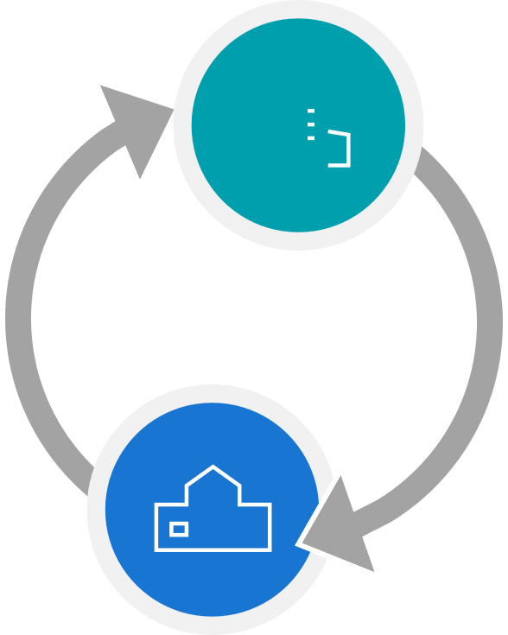
Better Coordination Through Real-Time Network Collaboration
The PointClickCare platform works in real-time, which means whether your patients are receiving care in a hospital ED, clinic, or other healthcare facility, you can receive up-to-date Insights into the status of your patients.
Hospital ED
Real-time notifications
Collaborate and share insights with
care team members
Comprehensive patient overview to help make informed decisions
Surface safety & security risks
Hospital
Ambulatory Setting
Real-time visibility into patient hospital encounters
Surfaces events of interest
Patient information and encounters visible to all care team members
Contribute to shared care plans
that are easily accessible
Ambulatory
Facility

Slide 13
Our Approach vs. the Standard Approach
Standard
Approach
Hospital staff stabilizes symptoms and patient is discharged home
Patient is expected to contact ambulatory facility on his or her own…
…more likely, patient returns to the ED the next time they have an acute episode
Patient with an outpatient provider arrives at hospital during an acute episode
Our Approach
Outpatient coordinates with the ED, help with assessment, and D/C planning
Notification is sent to hospital staff in real- time with patient Insights
Notification of acute encounter is sent to patient’s outpatient provider in real-time
Outpatient treatment starts upon discharge and patient is contacted proactively
Patient with an outpatient provider arrives at hospital with an acute episode

Slide 14
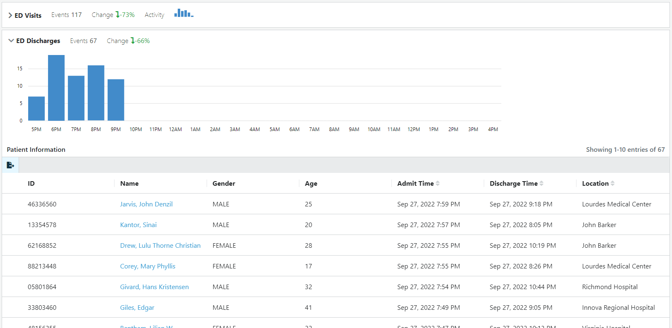
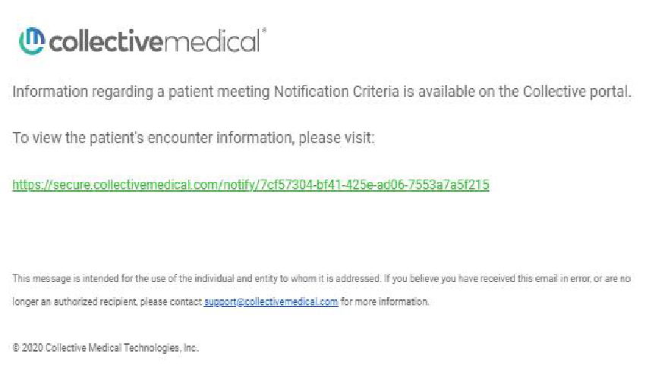
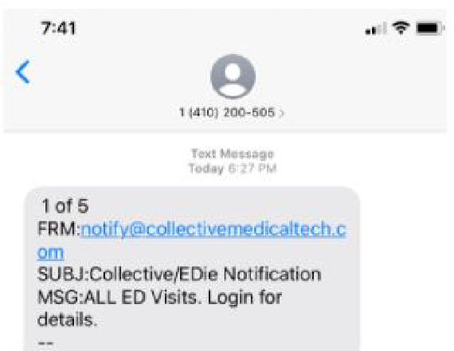
Events of Interest/Notifications
Standard Ambulatory Criteria
5+ ED Visits in 12 Months
3+ ED Visits in 3 Months
Inpatient Admissions
Inpatient Discharges
ED/OBS Encounter
ED/OBS Discharge
Behavioral Health Related ED Visits
More informed decisions
Impacts:
Improve the quality of care for the patient
Treatment and follow-up care occur through real-time collaboration
and communication

Slide 15
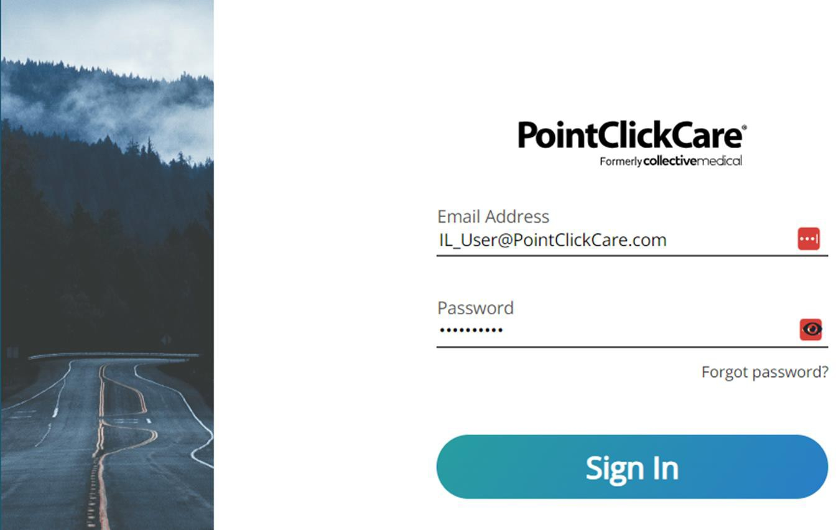
Web Based Portal
PointClickCare Web- Based Portal
Clicking the hyperlink in a notification will direct the user to the Patient Overview page within the portal.
Within the portal, you can:
View additional patient details
Document and update Care Insights
Add a safety & security event
View your patient census

Slide 16
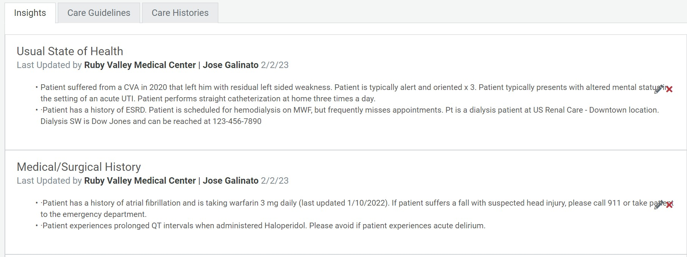
Care Insights: Sharing Essential Patient Information
Collaborative Insights automatically follow patients wherever they go on the PointClickCare network and are delivered in real-time to the point of care, directly integrated into existing workflows.
Contains curated, easy to consume, actionable information designed to support more informed-decision making, increased efficiency, and better outcomes.

Slide 17
Ambulatory Solution Features/Functionality
 | Standard Ambulatory Program
Census | Acute encounters and post-acute encounters
Cohorts | ED Encounters ED Discharges Inpatient Admissions Inpatient Discharges 3+ ED vis its in 3 Months 3+ ED vis its in 12 months BH ED Encounters | Enhanced Additional Criteria for BH Providers: ED Visits – Suicidal Ideation/Attempt or Self-Harm ED Visits – Opioid Overdose Dx ED Visits – Mental Health Dx ED Visits – Substance Use Dx ED Visits – Opioid Use Disorder Dx ED Visits – Alcohol Use Disorder Dx
Notifications | Optional, and can be applied to any cohort above. Standard types: secure email, printer, fax, text (SMS)
Scheduled Reports | Patient census: Daily (prior day), Weekly (prior 7 days),or monthly (previous month). Acute encounters only.
Tags | Cl inics with multiple locations can provide a ‘Location ID’ on the patient roster, which will reflect on the Patient Overvi ew page. Cl ients can manually add tags in the portal.
Flags | Users can view Flags created by other organizations on the Patient Overvi ew Page.
Consent | Included for BH providers
Patient Overview/Care Team/Care Insights | Included
User Accounts | 2-5 initial accounts created for key staff with super user training provided. Super user will create and manage additional accounts. SSO available.

Slide 18
How to Connect (Portal Access, EMR Integration, or Both)

Slide 19
Ambulatory and Community Provider Implementation
I. HFS Clinic Outreach and Engagement
HFS coordinates a webinar outreach campaign to invite facilities to a webinar/demo
Survey is sent to Clinics to identify engagement and prioritization.
https://www.surveymonkey.com/r/8T87FTX (Video Instructions/FAQ)
HFS sends the Collective Onboarding Packet to the facility/organization.
Included in onboarding packet: See IL HFS Onboarding Packet
Discovery Form https://pointclickcare.tfaforms.net/4676242
(Video Instructions/FAQ)
Terms and Conditions are completed by the facility/organization.
Engage Collective with clients that completed T&C
II. Collective Implementation Initiation
1. Collective receives clients with executed T&C, then Collective sends Onboarding Packet.
*See attached for Packet Information
III. Kick Off/ Implementation
(Once the client has filled out the discovery form and completed the click wrap agreement, a team member will then be assigned to the implementation and will kick off this stage)
Collective to set up Onboarding Kick Off Call
Set up portal or SFTP Access
Submit File for Validation and processing
Complete and return clinical onboarding forms
Schedule and complete Collective Platform training
Training follow-up and optimization
Submit second file and set to auto process
Client is Live and transition to support is initiated.

Slide 20
Eligibility File Uploads via Portal or SFTP
Active Patient population defined by customer
Manually upload through CM web-based portal
Population associated to your facility is visible on the Collective Network
Automated Uploads through SFTP
File Upload Frequency & Consistency are key to Success!

Slide 21
Eligibility File Specs
https://hfs.illinois.gov/content/dam/soi/en/web/hfs/healthchoiceadt/documents/Collecti veMedicalTechnologiesILPatientFileSpecs.xlsx

Slide 22
HealthChoice Illinois ADT Listserv
New listserv for HealthChoice Illinois ADT. If you would like to share this information for interested parties to sign up that would be great. We won’t send messages out too often, but they would include:
Information from our future Steering Committee when they provide guidance for portal usage, incentive programs, data quality initiatives, etc.
Announcements and links for registration for upcoming Clinical Collaboration Groups held via webinar.
Informative case studies and success stories they may help others use the portal in similar
ways.
Anyone can subscribe on the following public-facing webpage: https://hfs.illinois.gov/healthchoiceadt/notify.html
To subscribe, they need to choose HealthChoice Illinois ADT. After they submit their request, an email will be sent to the address they provided for verification.

Slide 23
Q & A

Slide 24
Save The Dates!
Upcoming Clinical Collaboration Events
2023 Clinical Collaboration Group Webinars – all provider types
Date: Thursday, August 3, 2023; 12pm – 1:00pm
Registration Link: Click Here to Register
Date: Thursday, November 2, 2023; 12pm – 1:00pm
Registration Link: Click Here to Register
Topics including:
Setting the group’s collaborative clinical initiative and its related goals
Monitoring/discussing progress toward goals and making adjustments
Patient level success stories
Workgroup recommendations
New Provider Notices
Platform enhancements

Slide 25
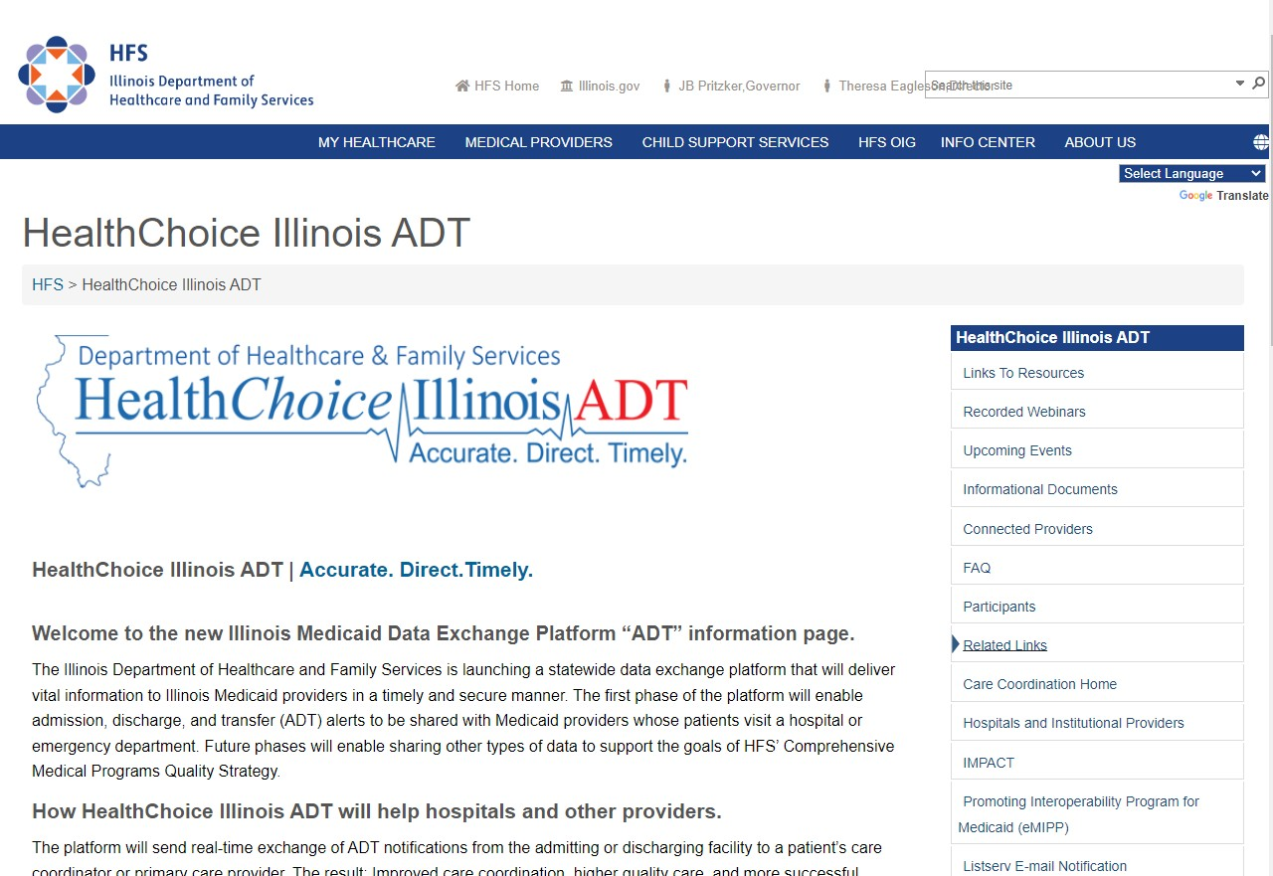
HealthChoice Illinois ADT Web Page
HealthChoice IL ADT Page

Slide 26
Resources
State HFS
Website: HealthChoice Illinois ADT HFS Program Email: HFS.HealthChoiceIllinoisADT@Illinois.gov
ListServ: Click to Subscribe Choose HealthChoice Illinois ADT
An email will be sent where additional verification must be confirmed.
Ambulatory and Community Provider Engagement: Survey
Collective Medical/PointClickCare Customer Community Site: https://community.collectivemedical.com/ Collective Medical Support Email: support@collectivemedicaltech.com
Let’s Get Engaged!
Want an in-person visit from Collective to help your team learn how to best use the platform? A specialized Zoom training?
Click here to schedule a call to discuss your needs!
Click Here

Slide 27
Appendix

Slide 28
Sample Daily Workflow
Designated Staff Log in Daily to PointClickCare (M-F)
Use Search bar for key patient look up | Review Census for recent ED & IP hospital activity | Review Cohorts
Review Patient Detail for Utilization Dx, Hx, Care Team and other content
Document hospital visit in patient chart/mail ED education letter | After ED visit, call patient to schedule PCP appointment | Coordinate Rx refills as needed | Develop care plan for patient following Inpatient discharge | Place patient on priority list for regular monitoring of hospital utilization
Continue monitoring patients via PointClickCare
Assess care coordination and referral needs for ED high utilizers | Assess transitional care needs for frequent Inpatient admissions/readmissions
Outcome: Clinic develops timely patient care plans informed by regular use of PointClickCare

Slide 29
Consent | Substance Use Disorder
42 CFR Part 2
42 CFR Part 2 is an added level of privacy for patients receiving care at SUD treatment facilities
Key Points:
SUD
Treatment facility
Added restriction to information sharing for SUD tx facilities
In Addition to HIPAA
Part 2 applies to a setting, not to content: SUD content
coming from an ED does not require consent to be shared;
content coming from an SUD treatment facility
HIPAA: Need TPO Relationships 42 CFR Part 2: Need Consent
(a Part 2 covered program) does require consent in order to be shared

